Slide 1
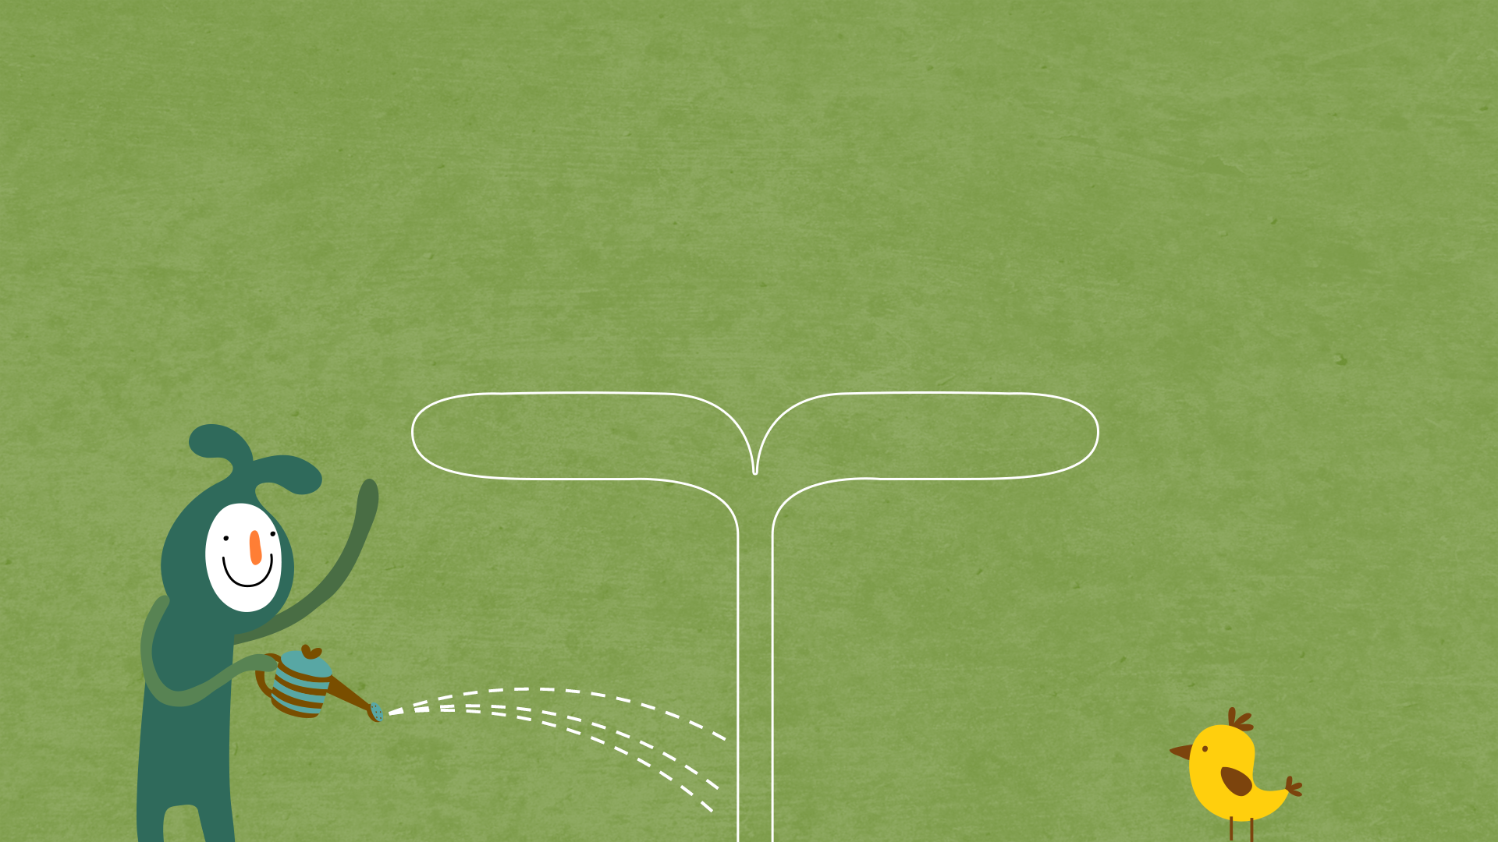

22년 삼성 AI 전문가과정
6월 7일 화요일 6교시
장병탁
인공지능
7차시 : Rule-Based Systems
서울대학교 컴퓨터공학부
담당 교수: 장병탁
Seoul National University
Byoung-Tak Zhang

Slide 2
Lecture Overview
인공지능
7차시 : Rule-Based Systems
서울대학교 컴퓨터공학부
담당 교수: 장병탁
Seoul National University
Byoung-Tak Zhang

Slide 3
Introduction
First-Order Logic (Previous lecture)
Intractable in practical applications
Confronting the real world
Horn clauses (PROLOG)
Less expressive
More efficient
Rule-based expert systems
Rule-based systems
Expert systems
Knowledge-based systems

Slide 4
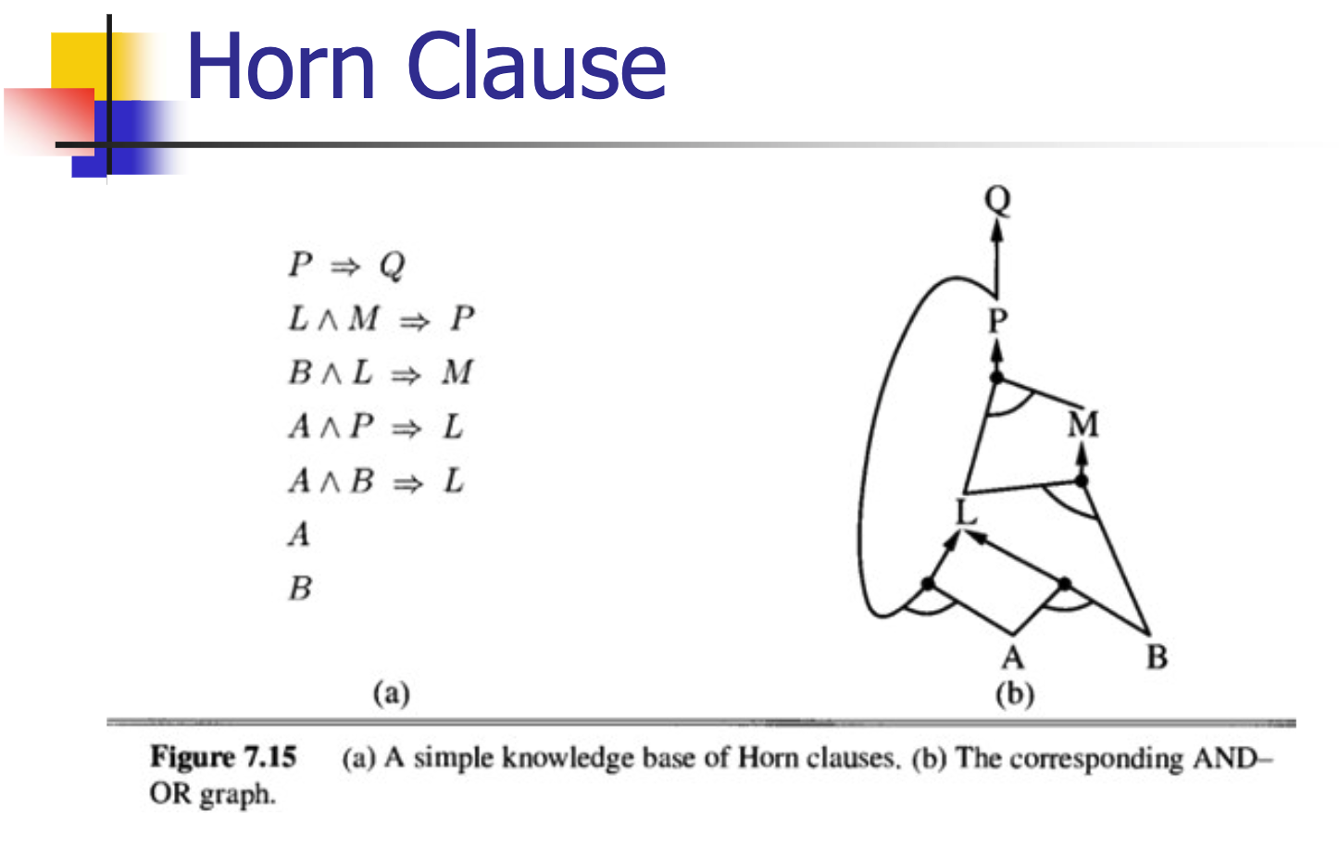
Reasoning Using Horn Clauses
Proof by AND/OR Tree

Slide 5
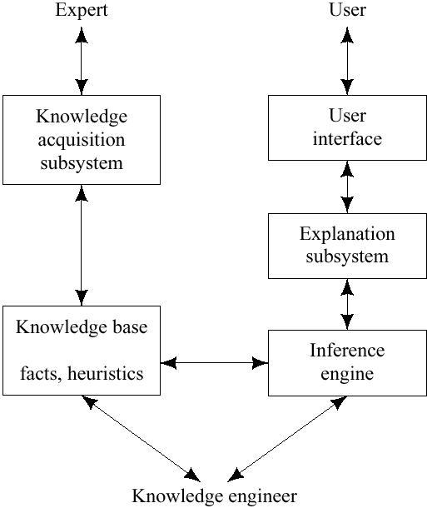
Rule-Based Expert Systems
Expert Systems
Inference engine & Knowledge base
“AI Programs that achieve expert-level competence in solving problems by bringing to bear a body of knowledge” [Feigenbaum, McCorduck & Nii 1988]
Expert systems vs. knowledge-based systems
Rule-based expert systems
Often based on reasoning with propositional logic Horn clauses.
Artificial Intelligence Chapter 17 knowledge-based systems Biointelligence Lab School of Computer Sci. & Eng. Seoul National University. - ppt download. SlidePlayer. (n.d.). Retrieved February 23, 2022, from https://slideplayer.com/slide/5260453/

Slide 6
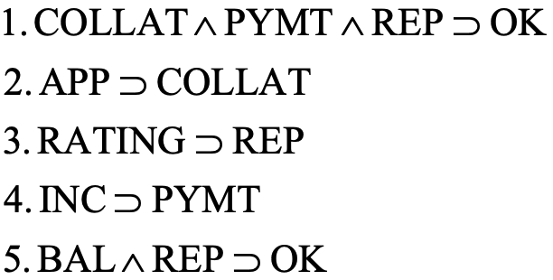
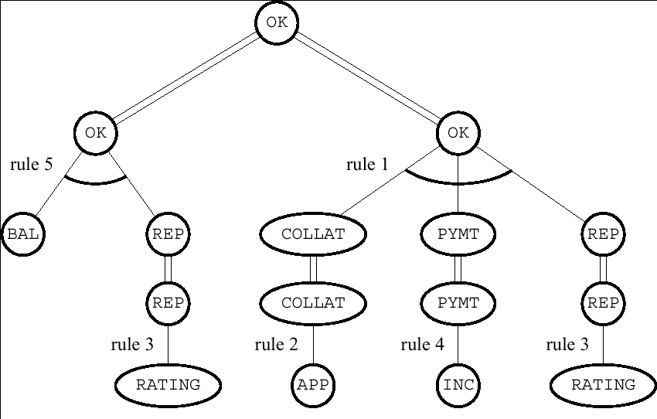

Lecture Overview
Confronting the Real World
Knowledge-based system, Predicate calculus
Reasoning Using Horn Clauses
Horn Clauses, PROLOG programs
Rule-Based Expert Systems
Expert Systems, Consulting system
Artificial Intelligence Chapter 17 knowledge-based systems Biointelligence Lab School of Computer Sci. & Eng. Seoul National University. - ppt download. SlidePlayer. (n.d.). Retrieved February 23, 2022, from https://slideplayer.com/slide/5260453/

Slide 7
Outline (Lecture 7)
7.1 Confronting the Real World ………………………
7.2 Reasoning Using Horn Clauses ………………….....
7.3 Rule-Based Expert Systems ……………………...
Summary ……………………………………………
8
12
19
29

Slide 8
7.1 Confronting the Real World

Slide 9
7.1 Confronting the Real World (1/3)
Knowledge-based systems
Programs that reason over extensive knowledge bases.
Do the methods scale up sufficiently well for practical applications?
Three major theoretical properties of logical reasoning systems
Soundness
To be confident that an inferred conclusion is true
Completeness
To be confident that inference will eventually produce any true conclusion
Tractability
To be confident that inference is feasible

Slide 10
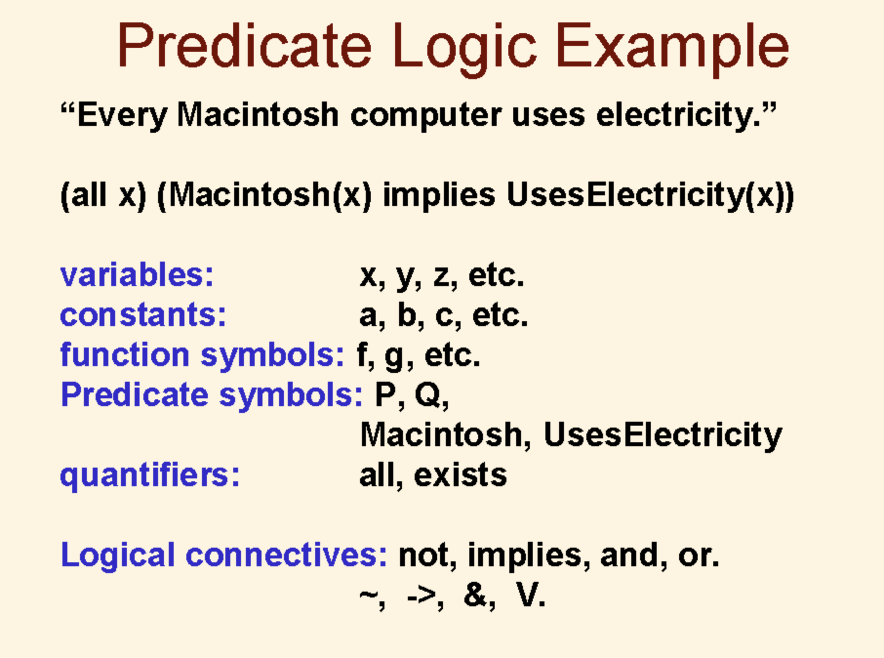
7.1 Confronting the Real World (2/3)
Predicate calculus (first-order logic)
Resolution refutation is sound and complete, but semi-decidable.
Semi-decidability makes the predicate calculus inherently intractable.
Even on problems for which resolution refutation terminates, the procedure is NP-hard.
This fact has led many to despair of using formal, logical methods for large-scale reasoning problems.
Predicate logic example. (n.d.). Retrieved February 23, 2022, from https://courses.cs.washington.edu/courses/cse341/03sp/slides/Prolog2/sld006.htm

Slide 11
7.1 Confronting the Real World (3/3)
To make reasoning more efficient
We could use procedures that might occasionally prove an untrue formula.
We could use procedures that might not be guaranteed to find proofs of true formulas.
We could use a language that is less expressive than the full predicate calculus.
Reasoning is typically more efficient with Horn clauses.

Slide 12
7.2 Reasoning Using Horn Clauses

Slide 13
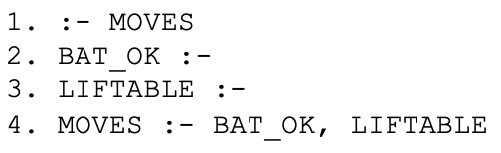
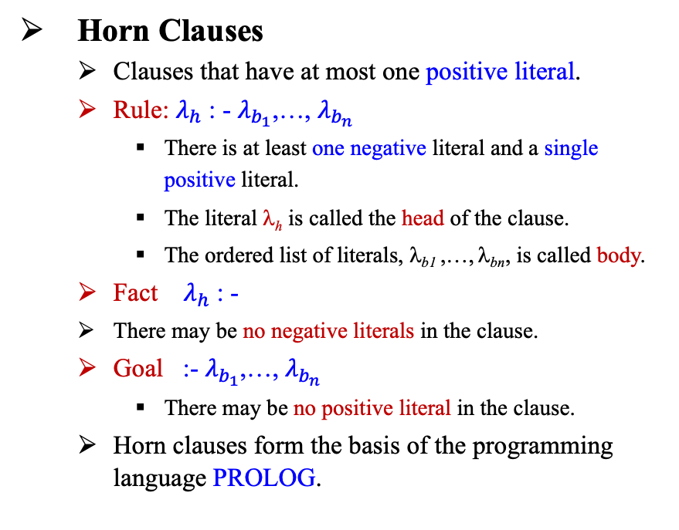
7.2 Reasoning Using Horn Clauses (1/6)
Horn Clauses
Clauses that have at most one positive literal.
Rule: $λ_{h}$ : - $λ_{b_{1}}$,…, $λ_{b_{n}}$
There is at least one negative literal and a single positive literal.
The literal λ_{h} is called the head of the clause.
The ordered list of literals, λ_{b1} ,…, λ_{bn}, is called body.
Fact $λ_{h}$ : -
There may be no negative literals in the clause.
Goal :- $λ_{b_{1}}$,…, $λ_{b_{n}}$
There may be no positive literal in the clause.
Horn clauses form the basis of the programming language PROLOG.
Lecture 7: Knowledge representation and Logic Heshaam Faili University of Tehran motivation knowledge bases and inferences logic as. - ppt download. SlidePlayer. (n.d.). Retrieved February 23, 2022, from https://slideplayer.com/slide/8248195/

Slide 14
7.2 Reasoning Using Horn Clauses (2/6)
Inference over PROLOG Clauses (1/2)
Resolution Operation
A goal can resolve with a fact by unifying the fact with one of the literals in the goal.
The resolvent is a new goal consisting of a list of all of the substitution instances of the other literals in the original goal.
A goal can resolve with a rule by unifying the head of the rule with one of the literals in the goal.
The resolvent is a new goal formed by appending the list of substitution instances of all of the literals in the body of the rule to the front of the list of substitution instances of all of the other (nonresolved-upon) literals in the goal.

Slide 15
7.2 Reasoning Using Horn Clauses (3/6)
Inference over PROLOG Clauses (2/2)
PROLOG programs
The clauses are usually ordered in the following way: goal, facts, rules.
Proof of a goal clause succeeds when the new goal produced by a resolution is empty.
Depth-first, backtracking search procedure
A goal clause fails if the interpreter has tried all resolutions for one of the goal literals and none results in new goals that can be proved.
The interpreter backtracks to the previous goal clause and tries other resolutions on it.

Slide 16
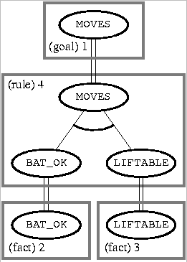
7.2 Reasoning Using Horn Clauses (4/6)
Example of an AND/OR Tree (1/2)
Body nodes are called AND nodes because they must all be proved.
If there had been alternative resolutions possible, the search for a proof tree could have generated additional nodes, called OR nodes.
Artificial Intelligence Chapter 17 knowledge-based systems Biointelligence Lab School of Computer Sci. & Eng. Seoul National University. - ppt download. SlidePlayer. (n.d.). Retrieved February 23, 2022, from https://slideplayer.com/slide/5260453/

Slide 17
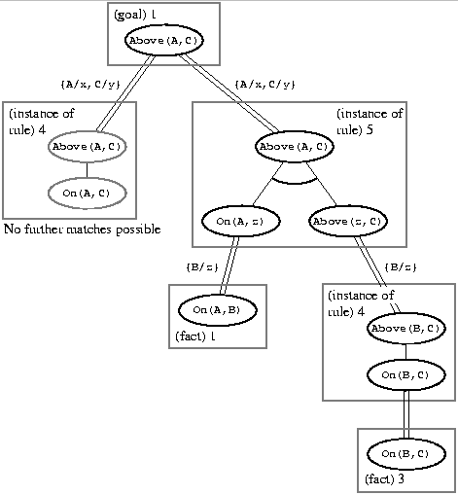
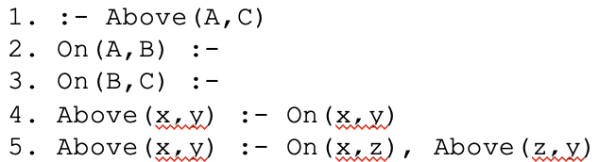
7.2 Reasoning Using Horn Clauses (5/6)
Example of an AND/OR Tree (2/2)
Consistency requires that the same term be substituted for the variable throughout the proof tree.
Artificial Intelligence Chapter 17 Knowledge-based Systems Biointelligence Lab School of Computer Sci. & Eng. Seoul National University. - ppt download. SlidePlayer. (n.d.). Retrieved February 23, 2022, from https://slideplayer.com/slide/5260453/

Slide 18
7.2 Reasoning Using Horn Clauses (6/6)
Forward chaining system (e.g., OPS5)
Reasoning proceeds forward, beginning with facts, chaining through rules, and finally establishing the goal.
A rule is applicable if each of the literals in its antecedent can be unified with a corresponding fact.
When more than one rule is applicable, some sort of external conflict resolution scheme is used to decide which rule will be applied.
Model of aspects of human cognitive processing
Facts: working or short-term memory
Rules: long-term memory

Slide 19
7.3 Rule-Based Expert Systems

Slide 20
7.3 Rule-Based Expert Systems (1/9)
Expert Systems
One of the most successful applications of AI reasoning technique using facts and rules
“AI programs that achieve expert-level competence in solving problems by bringing to bear a body of knowledge [Feigenbaum, McCorduck & Nii 1988]”
Expert systems vs. knowledge-based systems
Rule-based expert systems
Often based on reasoning with propositional logic Horn clauses.
Artificial Intelligence Chapter 17 Knowledge-based Systems Biointelligence Lab School of Computer Sci. & Eng. Seoul National University. - ppt download. SlidePlayer. (n.d.). Retrieved February 23, 2022, from https://slideplayer.com/slide/5260453/

Slide 21
7.3 Rule-Based Expert Systems (2/9)
Structure of Expert Systems
Knowledge Base
Consists of predicate-calculus facts and rules about subject at hand.
Inference Engine
Consists of all the processes that manipulate the knowledge base to deduce information requested by the user.
Explanation subsystem
Analyzes the structure of the reasoning performed by the system and explains it to the user.
Artificial Intelligence Chapter 17 Knowledge-based Systems Biointelligence Lab School of Computer Sci. & Eng. Seoul National University. - ppt download. SlidePlayer. (n.d.). Retrieved February 23, 2022, from https://slideplayer.com/slide/5260453/

Slide 22
7.3 Rule-Based Expert Systems (3/9)
Structure of Expert Systems
Knowledge acquisition subsystem
Checks the growing knowledge base for possible inconsistencies and incomplete information.
User interface
Consists of some kind of natural language processing system or graphical user interfaces with menus.
“Knowledge engineer”
Usually a computer scientist with AI training.
Works with an expert in the field of application in order to represent the relevant knowledge of the expert in a forms of that can be entered into the knowledge base.

Slide 23
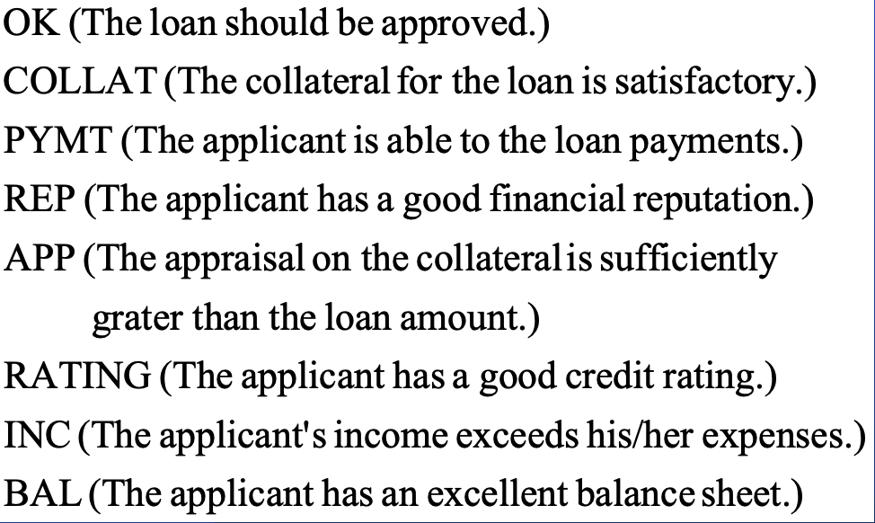
7.3 Rule-Based Expert Systems (4/9)
Example: loan officer in a bank
“Decide whether or not to grant a personal loan to an individual.”
Facts
Rules
Artificial Intelligence Chapter 17 Knowledge-based Systems Biointelligence Lab School of Computer Sci. & Eng. Seoul National University. - ppt download. SlidePlayer. (n.d.). Retrieved February 23, 2022, from https://slideplayer.com/slide/5260453/

Slide 24
7.3 Rule-Based Expert Systems (5/9)
To prove OK
The inference engine searches for AND/OR proof tree using either backward or forward chaining.
AND/OR proof tree
Root node: OK
Leaf node: facts
The root and leaves will be connected through the rules.
Using the preceding rule in a backward-chaining
The user’s goal, to establish OK, can be done either by proving both BAL and REP or by proving each of COLLAT, PYMT, and REP.
Applying the other rules, as shown, results in other sets of nodes to be proved.

Slide 25
7.3 Rule-Based Expert Systems (6/9)
By backward-chaining
Artificial Intelligence Chapter 17 knowledge-based systems Biointelligence Lab School of Computer Sci. & Eng. Seoul National University. - ppt download. SlidePlayer. (n.d.). Retrieved February 23, 2022, from https://slideplayer.com/slide/5260453/

Slide 26
7.3 Rule-Based Expert Systems (7/9)
Consulting system
Attempt to answer a user’s query by asking questions about the truth of propositions that they might know about.
Backward-chaining through the rule is used to get to askable questions.
If a user were to “volunteer” information, bottom-up, forward chaining through the rules could be used in an attempt to connect to the proof tree already built.
The ability to give explanations for a conclusion
Very important for acceptance of expert system advice.
Proof tree
Used to guide the explanation-generation process.

Slide 27
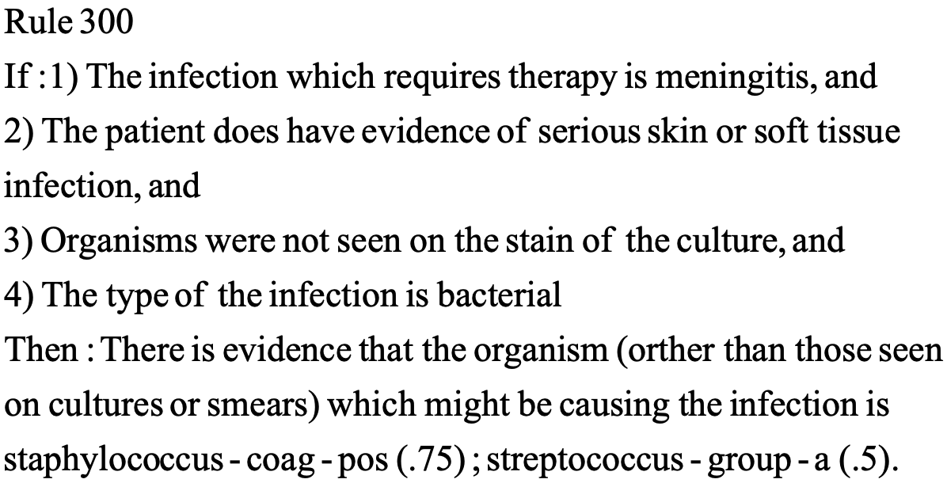
7.3 Rule-Based Expert Systems (8/9)
In many applications, the system has access only to uncertain rules, and the user not be able to answer questions with certainty.
MYCIN [Shortliffe 1976]: Diagnose bacterial infections.
Artificial Intelligence Chapter 17 Knowledge-based Systems Biointelligence Lab School of Computer Sci. & Eng. Seoul National University. - ppt download. SlidePlayer. (n.d.). Retrieved February 23, 2022, from https://slideplayer.com/slide/5260453/

Slide 28
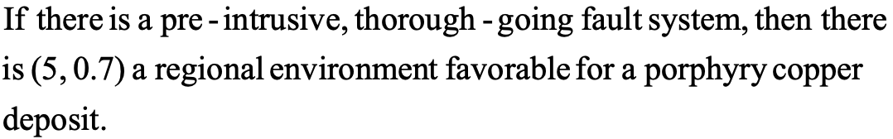
7.3 Rule-Based Expert Systems (9/9)
PROSPECTOR [Duda, Gaschnig & Hart 1979, Campbell, et al. 1982]
Reason about ore deposits.
The numbers (.75 and .5 in MYCIN, and 5, 0.7 in PROSPECTOR) are ways to represent the certainty or strength of a rule.
The numbers are used by these systems in computing the certainty of conclusions.
Artificial Intelligence Chapter 17 Knowledge-based Systems Biointelligence Lab School of Computer Sci. & Eng. Seoul National University. - ppt download. SlidePlayer. (n.d.). Retrieved February 23, 2022, from https://slideplayer.com/slide/5260453/

Slide 29
Summary
Knowledge-based systems are programs that reason over extensive knowledge bases.
Three major theoretical properties of logical reasoning systems.
→ 1) Soundness, 2) Completeness, 3) Tractability
Reasoning is typically more efficient with Horn clauses.
Forward, backward chaining are linear-time, complete for Horn clauses. Resolution is complete for propositional logic.
Reasoning proceeds forward, beginning with facts, chaining through rules, and finally establishing the goal.
Expert Systems: One of the most successful applications of AI reasoning technique using facts and rules.
→ Knowledge base, inference engine, explanation subsystem
Inductive rule learning: Creates new rules (Ex. neural networks)
Deductive rule learning: Enhances the efficiency of a system’s performance (Ex. EBG)
Propositional logic lacks expressive power

